Slide 1

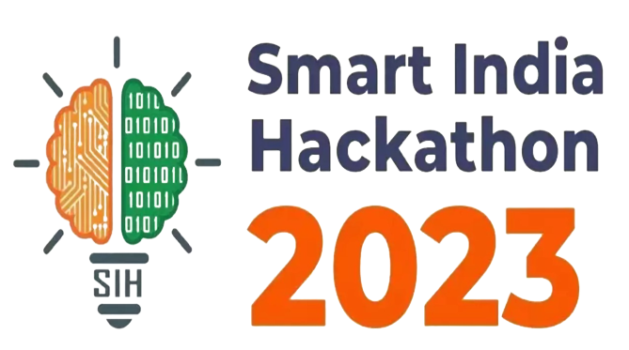


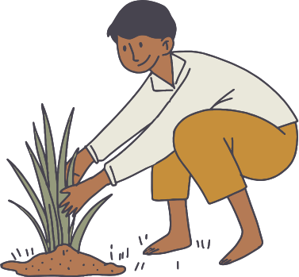


Team and Problem Statement
MISSION: App-Based Solution to identify and solve disease in plants/crops
Vision: integrating app development and AI to successfully develop an app that farmers could use to upload the photo of their diseased crop that can be processed by our model to identify the right plant pathogenist for their problem and receive prescriptions validated by them.

Slide 2
Team information
Team members
Ayush verma 2021UCD2134
bhumika bhatt 2021UCD2167
khush ahuja 2021UCD2130
ritul agarwal 2021UCD2127
tanuj chandela 2021UCD2124
Ayu﻿sh Chauhan 2021UCs2103

Slide 3

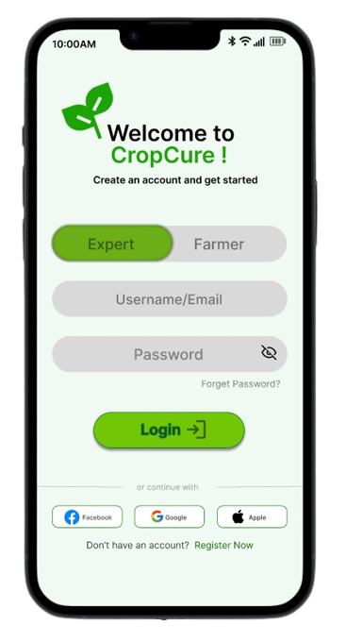
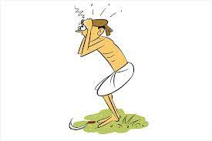

PAIN POINTS
MY CROP
HAS BEEN AFFECTED....
WHICH DISEASE??
WHICH TREATMENT ?
WHAT PRECAUTIONS ?
NOW WHAT?
WHO CAN GUIDE ME?
HOW TO SAVE IT !!!???

Slide 4
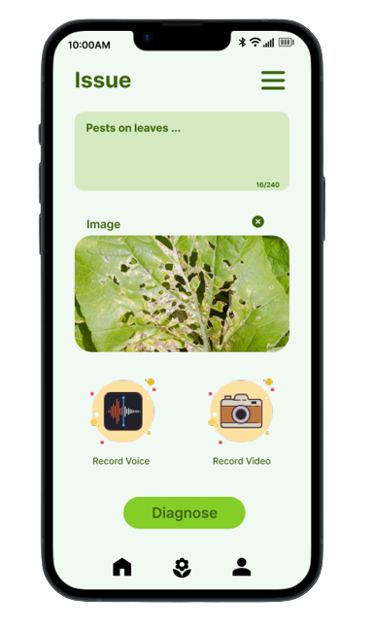

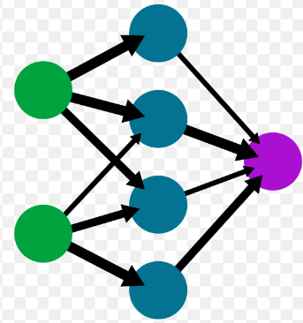
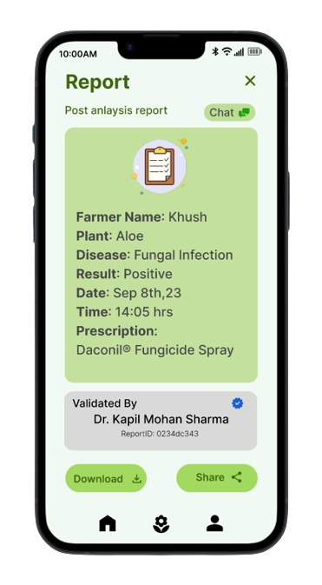
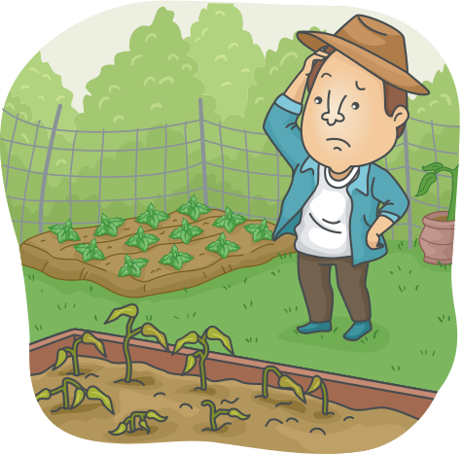

PROPosition
Image and Speech/Text if provided are cross-modalled and input to our model to detect the type of plant disease the crop is affected by.
Farmer can add image of crop, record his video or voice in his own regional language to describe the symptoms/ ill-effects and convey issues faced by the crop, write his concerns and upload on the app
Based on the disease identified, a plant pathogenist specialising in that type of plant disease could either validate the AI-generated prescription or if requested could cater to the needs of farmer and provide the solution as needed.

Slide 5


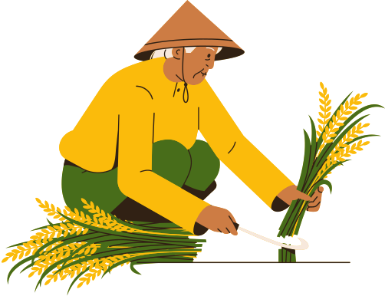
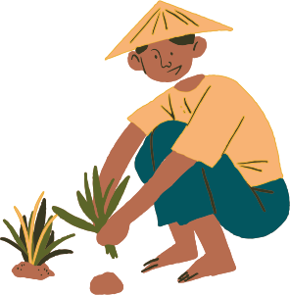
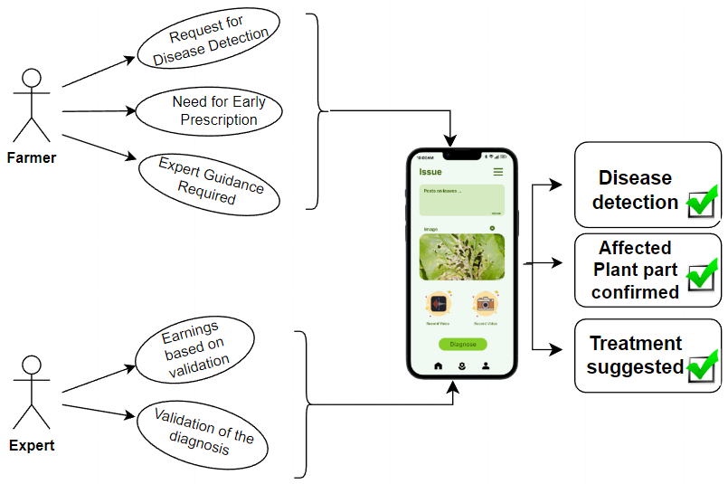
IMPLIED ADVANTAGE
Obtainment of labelled data for various diseases alongwith their prescriptions validated by experts across the plant kingdom, enhancing the model's learning capabilities as it becomes more widely utilized by farmers.
Value to User
Showstopper
Our app can translate every regional language ensuring accessibility for farmers pan-india.
Our app is scalable and could cater to multilple use cases like animal and human disease prescriptions, providing all specialists an easily accessible common platform to do social good.
Follow-up treatment and re-evaluation of crop health

Slide 6
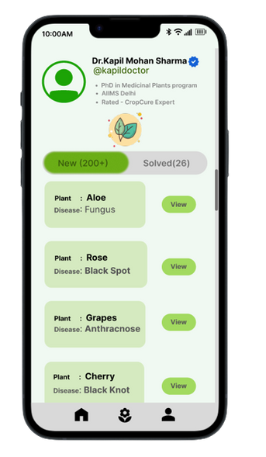


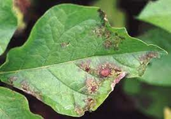

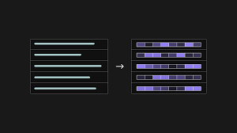
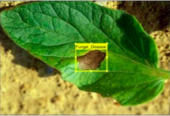


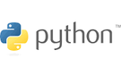




IDEA/APPROACH
CROP
CRISIS!!!
Image of the affected crop along with a video of the farmer is taken as input, its audio is extracted while detecting the regional language used.
Our speech recognition model finetuned on common regional languages translates input speech and provides dynamic translation support, then its converted to variable length keywords based on Language- agnostic BERT Sentence Encoder(LaBSE).
Cross modalling of text tokens alongwith the input image disease is inputted to the classification model
Attention-based context relevant searching of query is performed over the database and classification with CNN/DBN model to identify the most correlated disease with 97% accuracy.
After diagnosis of the disease, the farmer is given a prescription with suggestions validated by the apt experts
Audio
Transformers
Image
Database
Cross-Conditioning
(IMG/TXT)
Text-------Embedding
Model
Disease
Technologies Used

Slide 7
Business Model
Sources of Revenue
Government of India
Department of Agriculture and Farmers Welfare
Ministry of Agriculture
Asia and Pacific Plant Protection Commission (APPPC)
Paid services to consumers can generate revenue
Opportunities- As a service, Product
Potential business prospective is bright, considering its accessibility to users worldwide if proper access and data could be provided.
Not just farmer-crop issues but animal disease, human disease treatments, and prescriptions validated by experts
CRM or in our case, farmercrop relationship would be taken care of with frequent follow-ups and improved treatments while the problem persists.
Early detection and prescription to ensure no more crop wastage.
Provision of paid services to personal plantation/ garden owners
Intended Customer Base
Poor Farmers
Personal plantation/garden/home plant owners.
ADJACENT MARKETS
A similar app might exist, but our USP would be our model

Slide 8
Financial model and projections
Investment to develop- Material and manpower
ARCHITECTURE
App and model design already proposed previously.
A workable prototype could be developed at minimal cost, only needing to pay the expert
Manpower: 2 for model deployment
2 for app development
Assumptions
The plant village dataset, AI4Bharat dataset(IndicNLP) is used. We assume the validity and correctness of these datasets.
SCALABILITY
Scalable to users all-around the world
Scalable for other doctor-patient platfroms.
Return On Investment
Assured plant protection saving huge crop losses.
Saving 5-7 billion USD yearly due to Crop Loss

Slide 9
Competition & COMPETITIVE ADVANTAGES
DEFENSIBILITY
NICHE
A robust model that can identify disease with approximately 97% accuracy.
And referred to the specialised plant pathogenist with less number of waiting cases who can validate asap.
Specialise in Crop disease detection with farmer concern personalised reports.
Less Waiting Time to provide prescription
Strength of Technology
Our ML model is a CNN/DBN network
Also supports cross conditioning with farmer’s plight for personalization.
Recommends to best possible expert
Waiting time is as min as possible
USP
SOTA plant lesion segmentation techniques infused to predict disease
Waiting time is optimized.

Slide 10
ASSUMPTIONS and risks
THREATS, CONCERNS,RISKS
Our app cannot give proper results to farmers, due to wrong or in-understandable symptom description by the farmer
Our app prescription was too wrong that the farmer crop even got worse.
Farmers aren’t able to operate the app properly.
Doctors won’t give timely replies due to already loads of work.
PRECAUTIONS
Doctors must be given significant incentives by GOI for more validations that would encourage prompt validations by the doctor.
Model would be already tested before deployment on the application to avoid bad results.
RESPONSES
In wrong or inconsistent results being delivered by our model, model would be trained on more data, and would be improved.
Deeper model, better techniques on model like the denoising model would be applied to learn the latent/ hidden distribution of plant diseases with the iamges provided.
Self-Supervised methods of learning would be employed to make it learn better.

